Slide 1


Artificial Intelligence (Machine Learning & Deep Learning)
NAVTTC & Strings Technologies
by Salman Ahmad

Slide 2
Outline Week 6 Day 5
Decision Trees and Random Forest

Slide 3
What is a Decision Tree?
A non-parametric supervised learning algorithm used for classification and regression.
Mimics human decision-making by asking a series of yes/no questions.
Splits data based on feature thresholds to create a tree-like structure.
It has a hierarchical, tree structure, consisting of root node, branches and leaf nodes
The leaf nodes represent all the possible outcomes within the dataset.

Slide 4
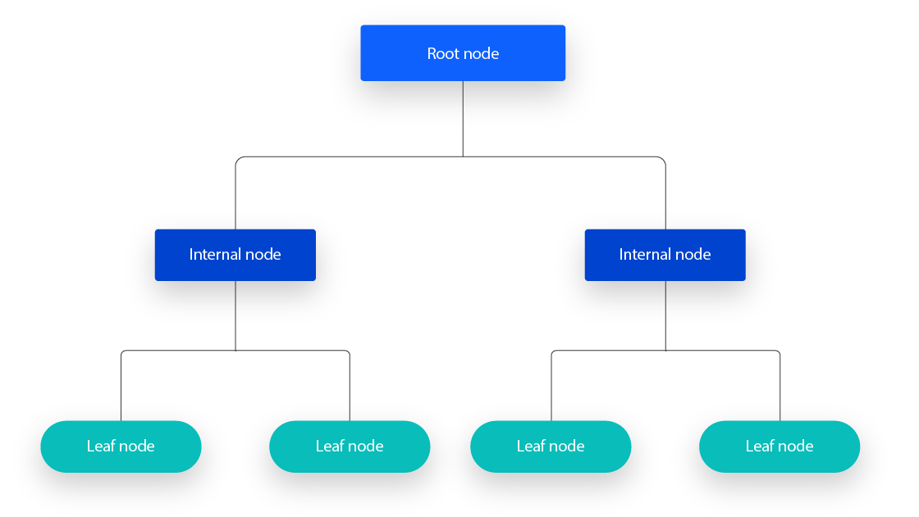
Core Concepts
Root Node: The first split based on the most informative feature.
Internal Nodes: Further splits based on feature conditions.
Leaf Nodes: Final prediction outcome (class or value).
Depth: Maximum number of levels in the tree.

Slide 5
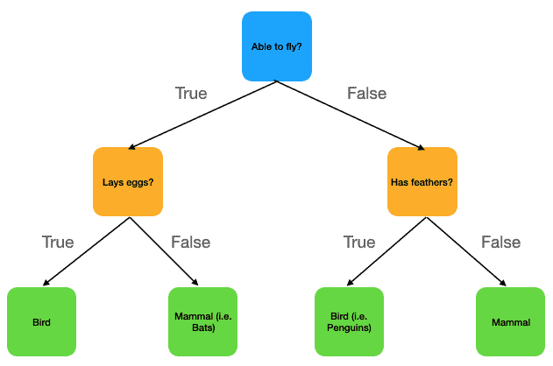
Core Concepts

Slide 6
How Does It Decide Splits?
Uses criteria to choose the best feature to split:
Gini Impurity (default for classification)
Entropy / Information Gain
Mean Squared Error (for regression)

Slide 7
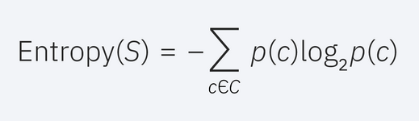
Entropy and information gain
Entropy stems from information theory
Measures the impurity of the sample values
Formula:
Ranges between 0 and log₂K (k=number of classes), 0 means pure with no impurity; all samples belong to the same class
Highest value means equal number of samples per class

Slide 8
Entropy and information gain
Formula:
S represents the data set that entropy is calculated
c represents the classes in set, S
p(c) represents the proportion of data points that belong to class c to the number of total data points in set, S

Slide 9
Information Gain
Information gain represents the difference in entropy before and after a split on a given attribute
The attribute with the highest information gain will produce the best split
Information Gain tells us how much ‘uncertainty’ is removed by knowing a feature.
Before splitting: node has high impurity (mixed labels)
After splitting: child nodes become more pure → less entropy
Gain = how much that purity increased

Slide 10
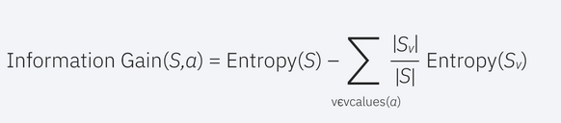
Information Gain
Formula:
a represents a specific attribute or class label
Entropy(S) is the entropy of dataset, S
|Sv|/|S| represents the proportion of the values in Sv to the number of values in dataset, S.

Slide 11
Limitation of Information Gain
Bias toward features with many values (e.g., ID numbers, zip codes)
Might overfit on noisy or unique features
Solution: Use Gain Ratio (used in C4.5) which penalizes high-branch features

Slide 12

Gini Impurity
A measure of impurity or disorder used by Classification and Regression Trees (CART)
Tells us how likely a randomly chosen element would be incorrectly labeled if randomly assigned according to the label distribution.
Formula:
K: number of classes
p_{i}: proportion of instances of class i in the dataset S

Slide 13
Use in Decision Trees
At each node, Gini is calculated for possible feature splits.
The feature that reduces Gini impurity the most is chosen.
Just like Information Gain (entropy), but uses Gini as the impurity measure.

Slide 14
NLP Example — Spam Classification
You have a binary dataset:
Feature: “contains the word 'offer’”
In the "yes" group: 8 spam, 2 not spam
Gini = 1 − (0.8)² − (0.2)² = 1 − 0.64 − 0.04 = 0.32
In the "no" group: 2 spam, 8 not spam → Gini = 0.32
Weighted Gini → used to decide if this feature is a good split

Slide 15
Decision Tree — Example
import pandas as pd
from sklearn.tree import DecisionTreeClassifier, plot_tree
import matplotlib.pyplot as plt
# Sample dataset
data = {
'Outlook': ['Sunny', 'Sunny', 'Overcast', 'Rain', 'Rain', 'Rain', 'Overcast', 'Sunny', 'Sunny', 'Rain'],
'PlayTennis': ['No', 'No', 'Yes', 'Yes', 'Yes', 'No', 'Yes', 'Yes', 'Yes', 'Yes']
df = pd.DataFrame(data)

Slide 16
Decision Tree — Example
# Convert categorical feature to one-hot encoding
X = pd.get_dummies(df[['Outlook']])
y = df['PlayTennis'].map({'Yes': 1, 'No': 0})
# Train decision tree using entropy
clf = DecisionTreeClassifier(criterion='entropy', max_depth=2, random_state=42)
clf.fit(X, y)
plt.figure(figsize=(8, 5))
plot_tree(clf, feature_names=X.columns, class_names=['No', 'Yes'], filled=True)
plt.title("Decision Tree Based on Outlook (Entropy)")
plt.show()

Slide 17
What is a Random Forest?
An ensemble of multiple decision trees.
Each tree is trained on a random subset of data and features.
Predictions are made via:
Majority vote (classification)
Average prediction (regression)
“Random Forest = Bagging (Bootstrap Aggregating) + Decision Trees”

Slide 18
Why Random?
Bootstrapping: Each tree sees a different subset of training data.
Feature randomness: At each split, only a random subset of features is considered.
This increases diversity among trees, reducing overfitting.

Slide 19
Benefits of Random Forest
Advantage | Description
Robust to overfitting | Aggregates many weak learners
High accuracy | Works well on both tabular and sparse data
Handles missing values | Well-tolerated by the forest
Feature importance | Can rank most influential features

Slide 20
Decision Tree vs. Random Forest
Feature | Decision Tree | Random Forest
Accuracy | Lower (risk of overfitting) | Higher (ensemble voting)
Interpretability | Easy | Harder (many trees)
Overfitting | Likely | Reduced
Training Time | Fast | Slower (many models)

Slide 21
Random Forest — Example
from sklearn.ensemble import RandomForestClassifier
from sklearn.feature_extraction.text import TfidfVectorizer
from sklearn.pipeline import make_pipeline
# Sample data
X = ["Good movie", "Horrible plot", "Loved the acting", "Worst ever", "Nice!"]
y = [1, 0, 1, 0, 1]
# Build model
model = make_pipeline(TfidfVectorizer(),RandomForestClassifier(n_estimators=100))
model.fit(X, y)
# Predict
print(model.predict(["Great direction"]))

Slide 22

Questions?
"He who asks a question is a fool for a minute; he who does not remains a fool forever." – Confucius

